Slide 1

International Schools in the U.S.
How emerging market wealth, policy, schools and university performance supported a rapid expansion of International Schools abroad and it’s extension into specific U.S. markets
15-Dec-2017
Kristine Adzema, Naga Pulivarthi, Sumana, Craig Bauer

Slide 2
Executive Summary
From CY2000-2016, International Schools for K12 have expanded in numbers and student enrollment 5.5x the rate of global population growth
This growth has stemmed from globalization, policy changes, but more commonly, native families you can now afford these schools which best prepared their children for top university acceptance around the world
While the U.S. continues to dominate top global universities rankings, it’s public K12 performance has slid below many of these emerging markets
An examination over this period illustrates a path from the growth in international schools and growth in international students to U.S. universities in specific markets
Coupled with immigration, the composition of these markets has grown in minority population percentage and household income. This has led to the expansion of International Schools in those U.S. markets and neighboring communities over the same period
Source: ISC Research and World Population by Year, WorldBank

Slide 3
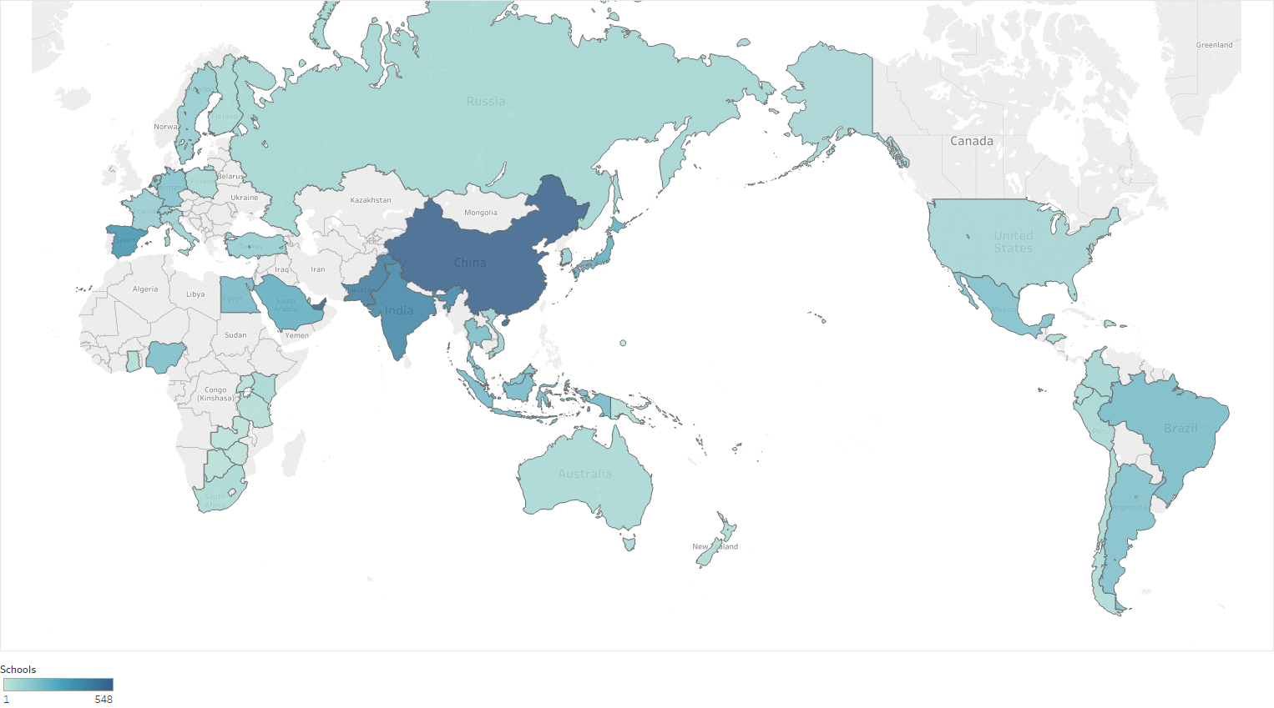
Expansion of K12 International Schools
Originally formed to serve EU, UK and U.S. ex-patriots abroad, International Schools provided English Medium curricula aligned for top-tier western university admission.
CY1986: <1,000 schools
CY2000: >2,500
CY2016: >8,200 schools serving 4.3 million students.
Source: ISC Research

Slide 4
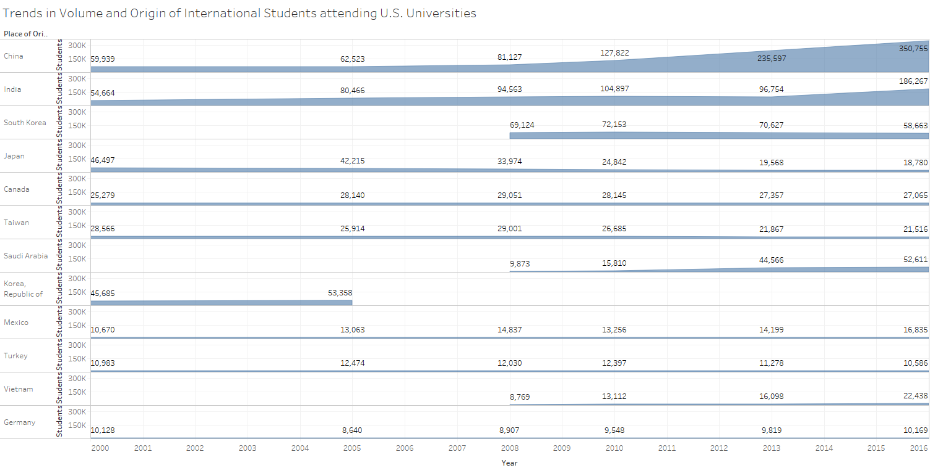
Volume and Origin of International Students attending U.S. Universities
Top country origins align with leading growth markets for International Schools
Source: IIE

Slide 5
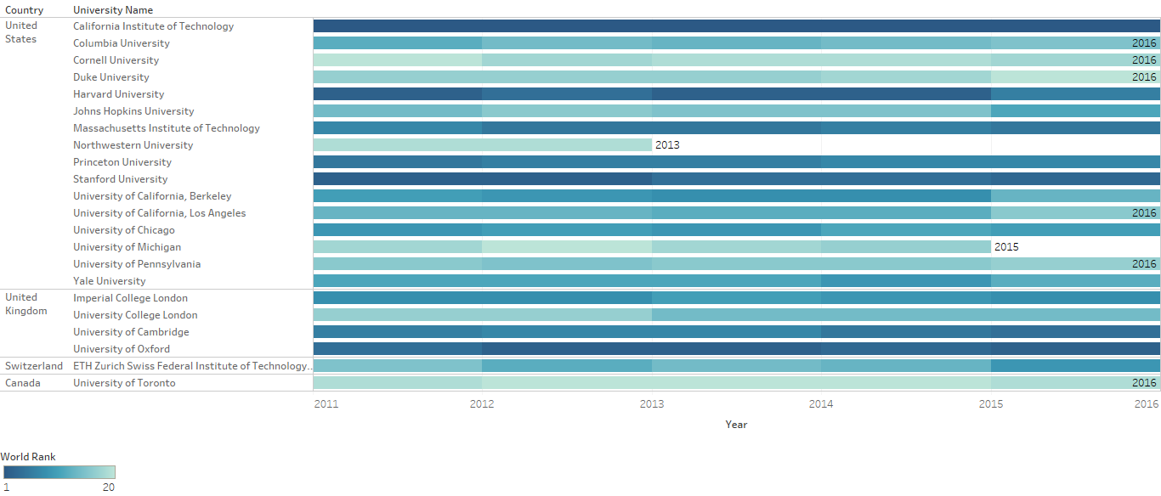
Rankings of Top Global Higher Education Universities
U.S. continues to lead top-20 global university rankings. These universities were also are incentivized to accept foreign student to bolster enrollment
Source: IIE
Notes:
The U.S. continues to dominate the list of global university rankings, typically holding top spots for Harvard, Stanford, and MIT year-over-year. The number of foreign student has also increased as these universities are incentivized to grow enrollment. This culminates into the U.S. being a leading country for international students.

Slide 6
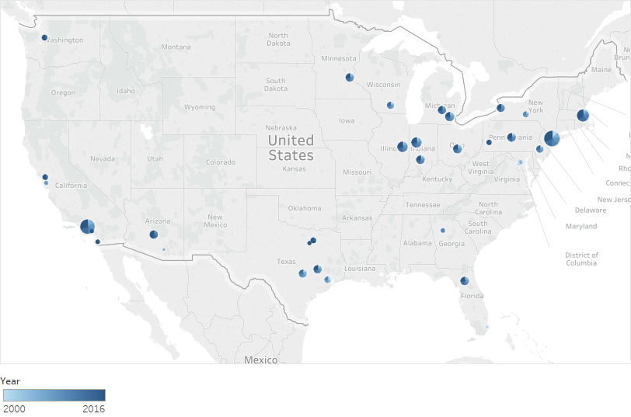
Growth of International Students University Destinations
The county destinations of international university students
Source: IIE
Notes:
As foreign student population has grown from 2000-2016 at these top universities and other leading schools, we can visibly see specific regions of concentrated growth. [transition to D3 map].

Slide 7
Trends in minority household composition by county
Source: 2000-2016 Census
Notes:
[in HTML and D3 charts] The 2016 census dataset alone illustrated which U.S. counties have the most ethnic diversity. With the 2000, 2005, 2008, 2010 and 2013 added, we can illustrate the rate of change and composition of each county.

Slide 8
Trends in minority household income composition by county
Source: 2000-2016 Census
Notes:
[in HTML and D3 charts] We can also isolate household income changes at various brackets as captured by the census data. This illustrates not just the change in race but a more astute change in minority household income by county

Slide 9



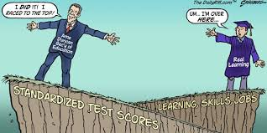
U.S. K12 School Programs & Policy
Despite Large Government Programs and K12 Privatization, most have failed in achieving promised outcomes
An alarming study links fraud in the Enron scandal to similar practices at charter schools - Business Insider, March 8, 2017
L.A. Unified takes a harder look at its charter schools. Critics blame politics - Los Angeles Times, Oct 24, 2016
Three Closing ASD Charter Schools Signal Larger Changes – Daily News Dec. 26, 2016
NYC Comptroller Finds Financial Irregularities at Success Academy Charter Schools – WSJ Dec. 19, 2016
Notes:
Though the U.S. leads in the world in top University rankings, the U.S. public K12 school system does not. There has been many government programs such as George Bush’s ‘No Child Left Behind’ and Obama’s ‘Race to the Top’, but each of these have failed in achieving the intended results. In addition, the privatization of schools including ‘charter schools’ have met with numerous scandals and subsequent closures.

Slide 10
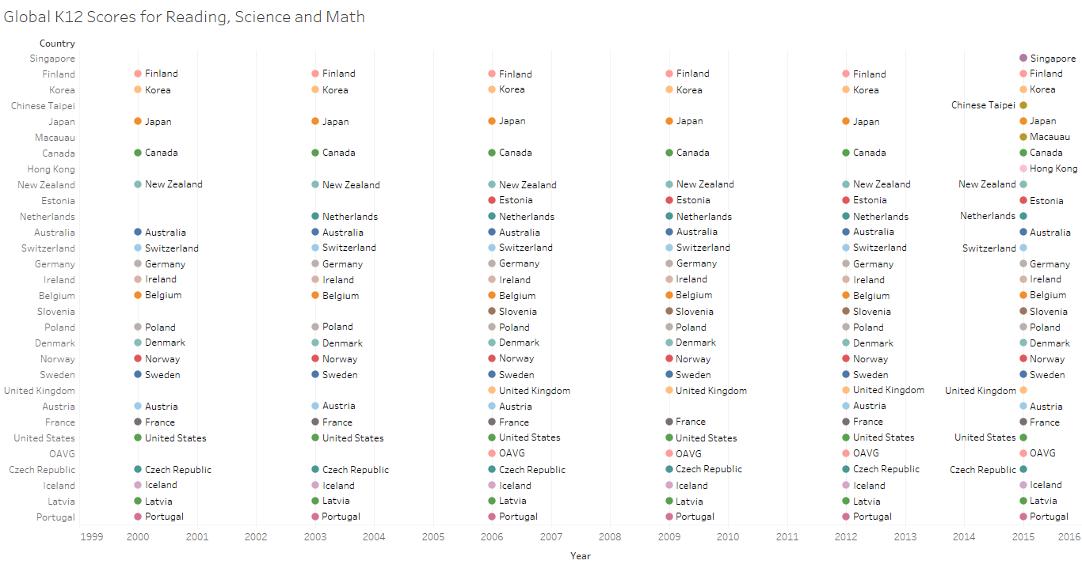
Rankings of Top Global K12 School Scores
In CY2015, the U.S. rankings fell to 35th from 28th in math and to 24th in science and Reading
Source: Organization for Economic Co-operation and Development (OECD) global rankings on student performance in mathematics, reading, and science, on the Program for International Student Assessment, or PISA.
Notes:
There are over 14,000 school districts in the U.S. and some of those do perform at the top levels. But in aggregate, the total U.S. K12 system does not and has also declined in rankings over the same 2000-2016 period despite the government and privatization programs mentioned.

Slide 11
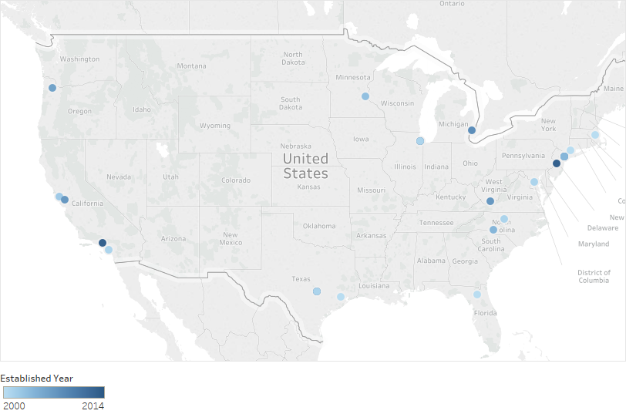
Expansion of International Schools in the U.S. by county
From CY2000-2015, 28 International Schools were added in these U.S. markets extending the current total to 73 schools
Source: Wikipedia
Notes:
This has led to an expansion of International School brands in the U.S. Though some schools have been in place for decades, from 2000-20014, the number has grown over 70%. Further analysis illustrates these new schools are in the same specific counties or neighboring counties where minority population and household income have grown the most rapidly.

Slide 12







Technology

